Slide 1

FINAL PROJECT SUBMISSION
Handwritten Digit Recognition
Applying Deep Learning in Pharmaceutical Research
Smrutirani Adhikari
Master of Pharmacy (Pharmacognosy) | Utkal University

Slide 2
Project Overview
A comprehensive 12-step implementation using TensorFlow and Keras to build a computer vision model for digit classification.

Slide 3

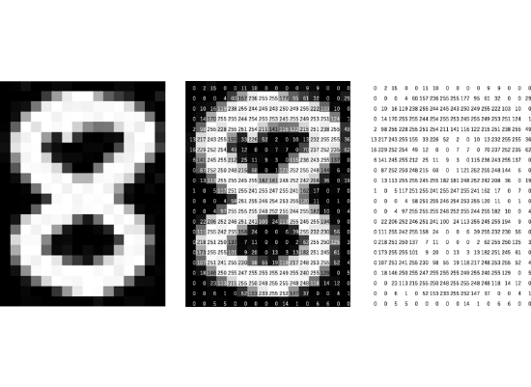
The MNIST Dataset
Standardized Data Source
The Modified National Institute of Standards and Technology (MNIST) dataset is the industry standard for testing image processing systems.
70,000 Grayscale images of digits 0-9.
28 x 28 pixel resolution per image.
Standard 60,000 train / 10,000 test split.

Slide 4


Methodology: Preprocessing
1. Normalization
2. Reshaping
Raw pixel values range from 0 to 255. We scale these values to a range between 0 and 1. This "normalization" ensures the mathematical gradients stay stable, leading to faster and more reliable model convergence.
Images are initially 2D matrices. To process them through a standard Multi-Layer Perceptron, we flatten the array into a 1D vector of 784 elements, serving as the input nodes for the neural network.

Slide 5





The Technology Stack
TensorFlow
Matplotlib
Google Colab
High-performance library for numerical computation and large-scale machine learning.
Essential for visualizing the training history and verifying prediction outputs.
Cloud-based development environment utilizing GPU acceleration for training.

Slide 6
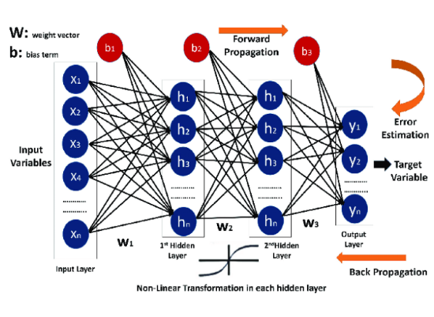
Neural Network Architecture
We implemented a Sequential model representing a Multi-Layer Perceptron (MLP) with the following structure:
Input Layer: 784 flattened pixels.
Hidden Layers: 2 Dense layers with 50 neurons each (ReLU activation).
Output Layer: 10 neurons with Sigmoid/Softmax activation.

Slide 7
Hyperparameters & Configuration
Parameter | Selection | Description
Optimizer | Adam | Efficient stochastic gradient descent algorithm.
Loss Function | Sparse Categorical Crossentropy | Used for multi-class classification tasks.
Epochs | 10 | Number of full passes through the training set.
Metrics | Accuracy | Primary measure of model performance.

Slide 8

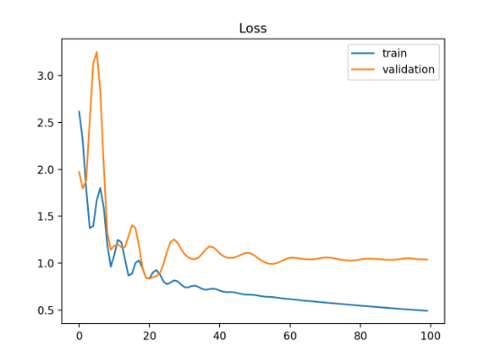
Performance Analysis
98.9%
Training Accuracy
Over 10 epochs, the model successfully minimized loss and reached near-human levels of digit recognition, as seen in the training history.

Slide 9



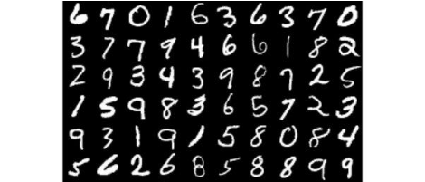
Real-World Verification
Test Prediction
Final Reliability
The model was verified using unseen test data. In our final test, the digit "7" was correctly identified with absolute precision, matching the ground-truth label.
The final test accuracy achieved was 97.08%. This high score confirms that the model generalizes well to new data and is ready for pharmaceutical application.

Slide 10
Pharmacognosy Application
As a Master of Pharmacy student, the core objective is to bridge the gap between AI and Botanical Science.
Automated identification of medicinal plant leaf sections (T.S.).
Detection of adulterants in herbal powders using computer vision.
Faster drug discovery through chemical structure recognition.

Slide 11
Conclusion & Future Scope
Workflow Validated: Successfully implemented the full 12-step Deep Learning pipeline.
Optimized Model: Achieved 97.08% test accuracy with an efficient MLP architecture.
Next Steps: Transitioning to Convolutional Neural Networks (CNNs) for complex botanical image classification.
Integration: Using these AI foundations to enhance pharmaceutical quality control and phytochemical standardization.

Slide 12

Questions?
Thank you for your valuable time and attention.
Smrutirani Adhikari
M.Pharm (Pharmacognosy) | Utkal University

